Slide 1
Uber Ride Data Analysis

Slide 2
NAME: R.VINOTH KUMAR
INSTITUTION: LOGIN 360
GUIDE: SANGEETHA MAM

Slide 3
INTRODUCTION
Purpose of the analysis
Dataset size: 1000 rides
Columns: Ride Date/Time, Pickup, Dropoff, Distance, Fare, Payment Method, Passenger Count, Driver Rating

Slide 4
SUMMARY INSIGHTS
Total Rides: 1000
Average Fare: $53.17
Average Distance: 15.57 km
Average Driver Rating: 3.99
Avg. Passengers per Ride: 3.57

Slide 5
PAYMENT METHODS
Most used: Wallet
Others: Cash, Card
Insight: Wallet usage is higher → digital adoption trend

Slide 6
FARE & DISTANCE ANALYSIS
Average Fare: $53.17
Longest trips: Higher fares, more distance
Potential outliers in fares (if some values are too high/low)

Slide 7
DRIVER RATINGS
Average Rating: 3.99
Range: 1–5
Insight: Majority of drivers perform well (above 3.5)

Slide 8
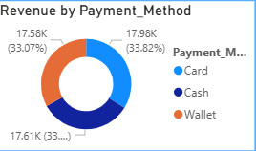
PAYMEN METHOD BY REVENUE

Slide 9

TOTAL RIDE

Slide 10
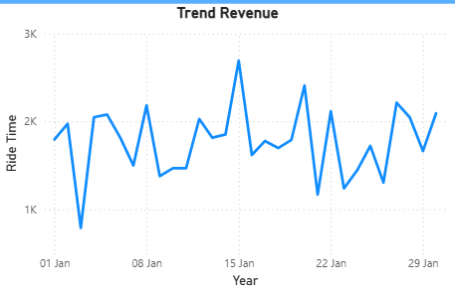
TOTAL REVENUE BY YEAR

Slide 11
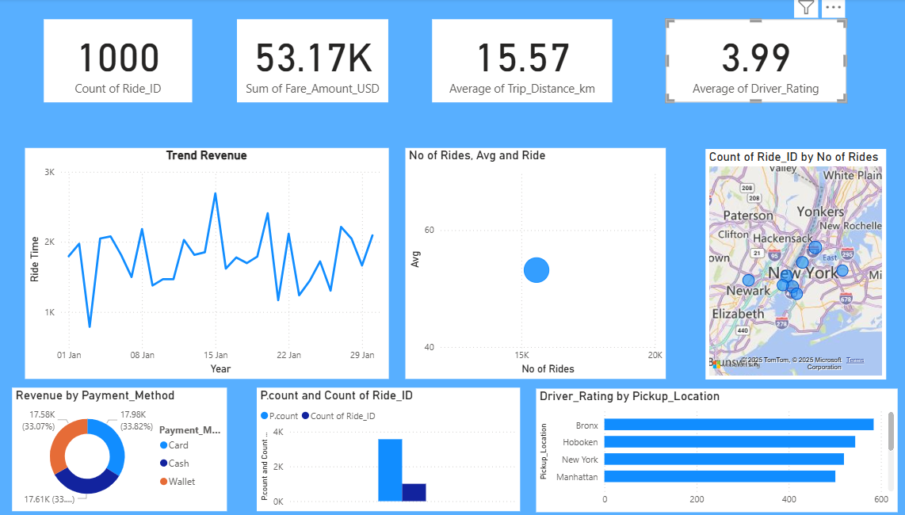
FINAL

Slide 12
Conclusion
Uber rides show urban commuting patterns
Digital payments are dominant
Ratings are generally positive
Analysis can help optimize driver allocation & pricing

Slide 13


